Slide 1

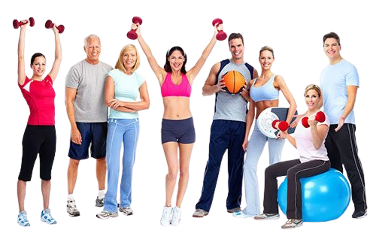



ICON Fitness
The Brilliance in Fitness
Home
Services
Success Stories
Contacts
Login
We create shapes.
Your body is your Temple
and needs to be tended to in the best manner possible.
It is the finest and most valuable instrument ever created
but it also has to be harmonize with the inner you.
We believe in exercise
that shapes and
strengthens body and soul.

Slide 2
ICON Fitness
The Brilliance in Fitness
Home
Services
Success Stories
Contacts
Login
10 Reasons to Choose Us…
1 |  | Wide range of strength equipment’s with around 30 workout machines for beginners as well as for professional athletes. | 6 |  | Energetic sound system and 2 smart TVs to feel liveliness on both floor.
2 |  | Wide range of weights e.g. dumbbells up to 40 kg and plates more than 1000 kg. for professional athletes. | 7 |  | Clean / hygienic / energetic Floor area with smoothing air freshener.
3 |  | Wide range of cardio equipment’s with around 4 treadmills, 2 cross trainer, 2 spinning bikes, 1 recumbents bike. | 8 |  | Hassle Free Biomatrix entry with CC TV surveillance.
4 |  | Separate massage and steam room to relax & recover your muscles sourness. | 9 |  | Certified Well experience and well qualified gym Trainers and well capable to handle special population.
5 |  | Not too Big Not too Short – Ample of space including ground floor as well as 1st floor. Try to maintain privacy for ladies. | 10 |  | Successful 6 years gym experience with happy & Satisfied Members.
No of Weight Machine
Energetic Environment
Dumbbells & Plates
Cleanliness
No of Cardio Machine
Biomatrix & CC tv
Massage & Steam
Certified Trainer
Huge Space
Happy
Gym Members

Slide 3

ICON Fitness
The Brilliance in Fitness
Home
Services
Success Stories
Contacts
Login
Strength Training
What Is Strength Training
Benefits of Strength Training
What we are Offering…
Weight training is a form of exercise where weights and the force of gravity combine to build and strengthen skeletal muscles. Regardless of age or gender, you can benefit from weight training.
Increases muscle and bone strength
Fat Loss
Increases Energy
Increases Metabolic Rate
Shapes your body
And much more…………….
From free weights to static weights, dumbbells , chest press or leg curl machines, ICON Fitness have everything you need for muscle toning and building.

Slide 4
ICON Fitness
The Brilliance in Fitness
Home
Services
Success Stories
Contacts
Login
Cardio Training
What Is Cardio Vascular
Benefits of Cardio Vascular Training
What we are Offering…
Any exercise that strengthens your heart and lungs while burning Calories.
.
Makes the heart and lungs stronger
Lowers blood pressure & cholesterol
Increases energy
Reduces stress And Much More…….
We are having international standard Treadmills, Elliptical/Cross Trainers
And Recumbent bike to enhance your cardio vascular strength and burn calories.

Slide 5
ICON Fitness
The Brilliance in Fitness
Home
Services
Success Stories
Contacts
Login
Personal Training
What Is Personal Training
Benefits of Personal Training
What we are Offering…

Slide 6
ICON Fitness
The Brilliance in Fitness
Home
Services
Success Stories
Contacts
Login
Cross Fit Training
What Is Functional Training
Rather than focusing on one single muscle group, Functional training gives you the freedom to mimic natural forms of movement in all directions.
It'll train your body for activities performed in everyday life so you'll perform better at work and at home.
Improve your mobility, flexibility, balance and strength in all areas and decrease injuries and joint pain.
Helps to reduce your fats and gain muscles.

Slide 7

ICON Fitness
The Brilliance in Fitness
Home
Services
Success Stories
Contacts
Login
Nutritional Counseling
Do you required Nutrition ?
If you feel tired halfway through your workout, you may not be eating enough. If you are gaining weight, you might be eating too much. If you are unintentionally losing weight, have a healthy snack in the afternoon before you head to the gym. Either way, your diet is not balanced, and the calories you ingest do not match the calories you expend. Your diet is most likely in balance once you are able to maintain a stable weight.

Slide 8
ICON Fitness
The Brilliance in Fitness
Home
Services
Success Stories
Contacts
Login
Massage
Do you required Massage ?
Helps recovery from soft tissue injuries such as sprains and strains.
Tissue growth and repair is accelerated by efficient circulation and stimulation.
Increase the blood's oxygen capacity by 10-15%
Speed recovery from exercise-induced fatigue.
Various Injuries massage treat like Headaches and Migraines, Frozen Shoulder, Back Pain, and Much more………..

Slide 9
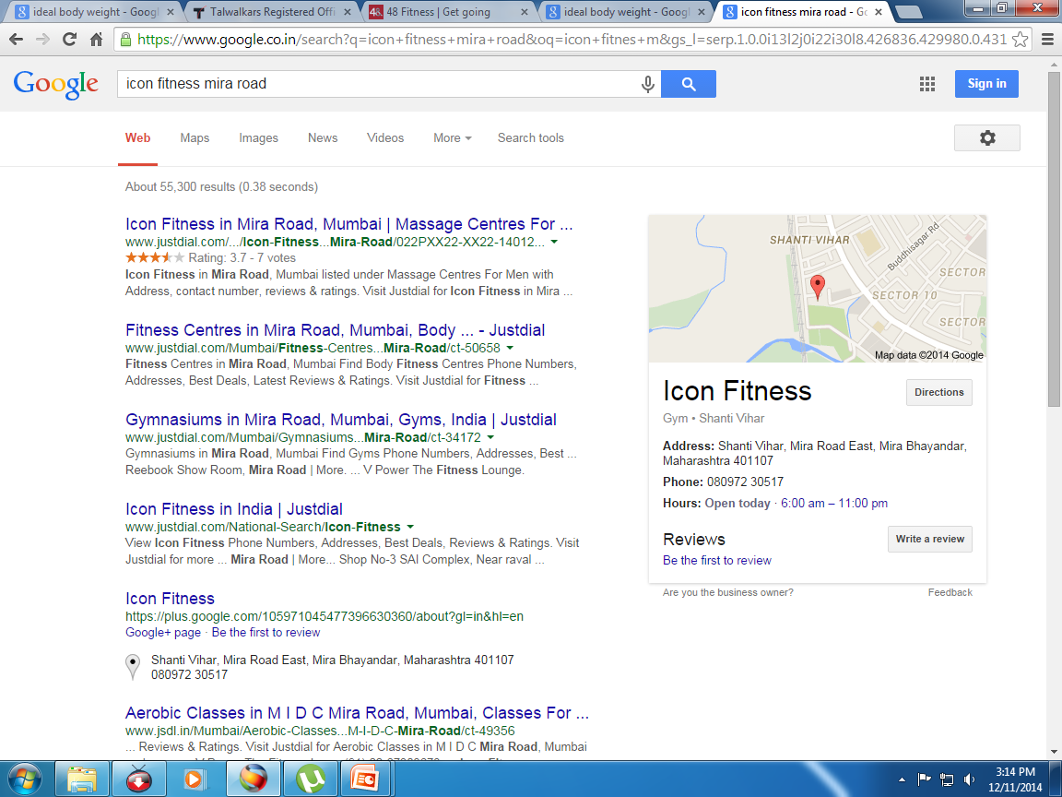
ICON Fitness
The Brilliance in Fitness
Home
Services
Success Stories
Contacts
Login
Address
Google Map
Rohini Group,
ICON Fitness,
Shanti Vihar B2, Near Hardik Palace Hotel, Station Road, Mira Road – East, 40117
Mob No - 91 8097230517
Mob No - 91 9920230517
Opening Hours
Mon To Sat – 06.00 AM To 11.00 PM
Sunday – 08.00 AM To 12.00 AM

Slide 10
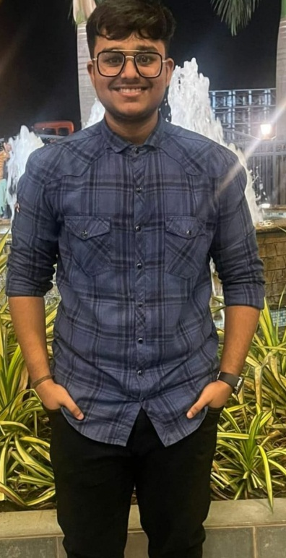

ICON Fitness
The Brilliance in Fitness
Home
Services
Success Stories
Contacts
Login
Aijan Kadiwal
97 kg – 83 kg
“ Believe
You Can and You Will “
ICON Fitness
The Brilliance in Fitness

Slide 11


ICON Fitness
The Brilliance in Fitness
Home
Services
Success Stories
Contacts
Login
Shabana
77 kg – 65 kg
I am Proud
On Myself, For Myself, By Myself …
ICON Fitness
The Brilliance in Fitness

Slide 12


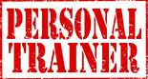
ICON Fitness
The Brilliance in Fitness
Home
Services
Success Stories
Contacts
Login
Supriya Nair
77.5kg – 71kg
“ Success is not an Activity
But a Process ”
ICON Fitness
The Brilliance in Fitness

Slide 13

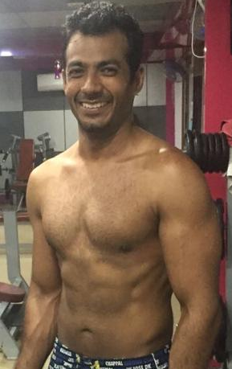
ICON Fitness
The Brilliance in Fitness
Home
Services
Success Stories
Contacts
Login
Mitesh Thakkar
“Addicted to getting Stronger”
ICON Fitness
The Brilliance in Fitness

Slide 14




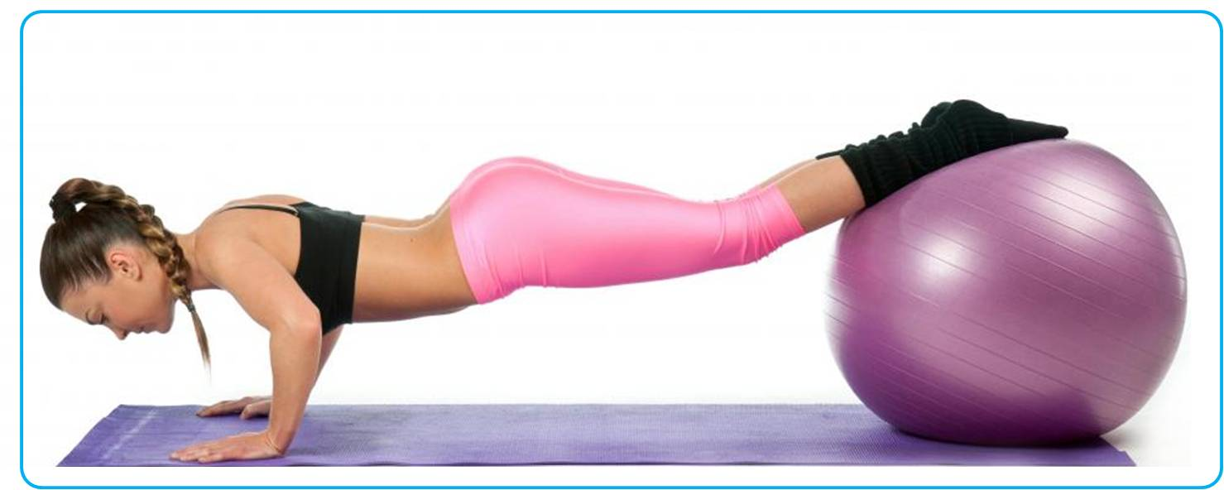
ICON Fitness
The Brilliance in Fitness
Home
Services
Calculators
Success Stories
Contacts
We create shapes
Your body is your Temple and needs
to be tended to in the best manner possible.
It is the finest and most valuable instrument ever created but it also has to be harmonize with the inner you. We believe in exercise that shapes and strengthens body and soul.

Slide 15
ICON Fitness
The Brilliance in Fitness
Home
Services
Calculators
Success Stories
Contacts
We create shapes
Your body is your Temple and needs
to be tended to in the best manner possible.
It is the finest and most valuable instrument ever created but it also has to be harmonize with the inner you. We believe in exercise that shapes and strengthens body and soul.

Slide 16
ICON Fitness
The Brilliance in Fitness
Home
Services
Calculators
Success Stories
Contacts
We create shapes
Your body is your Temple and needs
to be tended to in the best manner possible.
It is the finest and most valuable instrument ever created but it also has to be harmonize with the inner you. We believe in exercise that shapes and strengthens body and soul.

Slide 17
ICON Fitness
The Brilliance in Fitness
Home
Services
Calculators
Success Stories
Contacts
We create shapes
Your body is your Temple and needs
to be tended to in the best manner possible.
It is the finest and most valuable instrument ever created but it also has to be harmonize with the inner you. We believe in exercise that shapes and strengthens body and soul.

Slide 18
ICON Fitness
The Brilliance in Fitness
Home
Services
Calculators
Success Stories
Contacts
We create shapes
Your body is your Temple and needs
to be tended to in the best manner possible.
It is the finest and most valuable instrument ever created but it also has to be harmonize with the inner you. We believe in exercise that shapes and strengthens body and soul.

Slide 19
ICON Fitness
The Brilliance in Fitness
Home
Services
Calculators
Success Stories
Contacts
Services
Strength Training
Cardio Vascular Training
Weight Loss Training
Personal Training
Nutritional Counseling
Massage

Slide 20

ICON Fitness
The Brilliance in Fitness
Home
Services
Calculators
Success Stories
Contacts
Services
Strength Training
Strength Training
What Is Strength Training
Benefits of Strength Training
What we are Offering…
Weight training is a form of exercise where weights and the force of gravity combine to build and strengthen skeletal muscles. Regardless of age or gender, you can benefit from weight training.
Increases muscle and bone strength
Fat Loss
Increases Energy
Increases Metabolic Rate
Shapes your body
And much more…………….
From free weights to static weights, dumbbells , chest press or leg curl machines, ICON Fitness have everything you need for muscle toning and building.

Slide 21
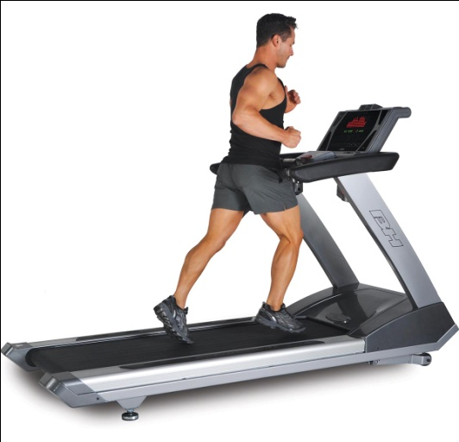
ICON Fitness
The Brilliance in Fitness
Home
Services
Calculators
Success Stories
Contacts
Services
Cardio Vascular Training
Cardio Vascular Training
What Is Cardio Vascular
Benefits of Cardio Vascular Training
What we are Offering…
Any exercise that strengthens your heart and lungs while burning Calories.
.
Makes the heart and lungs stronger
Lowers blood pressure & cholesterol
Increases energy
Reduces stress And Much More…….
We are having international standard Treadmills, Elliptical/Cross Trainers
And Recumbent bike to enhance your cardio vascular strength and burn calories.

Slide 22
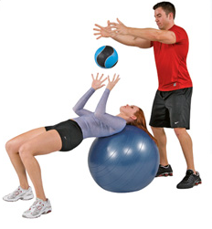
ICON Fitness
The Brilliance in Fitness
Home
Services
Calculators
Success Stories
Contacts
Services
Personal Training
Personal Training
What Is Cardio Vascular
Benefits of Cardio Vascular Training
What we are Offering…

Slide 23
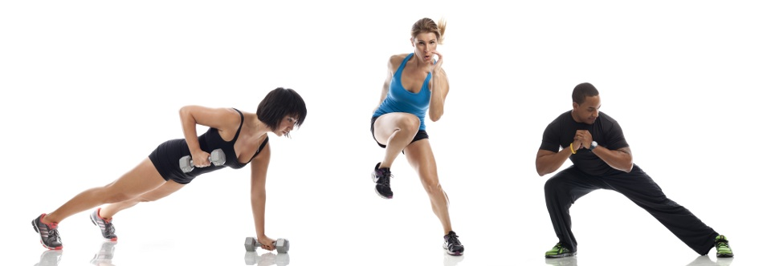
ICON Fitness
The Brilliance in Fitness
Home
Services
Calculators
Success Stories
Contacts
Services
Functional Training
Functional Training
What Is Functional Training
Rather than focusing on one single muscle group, Functional training gives you the freedom to mimic natural forms of movement in all directions.
It'll train your body for activities performed in everyday life so you'll perform better at work and at home.
Improve your mobility, flexibility, balance and strength in all areas and decrease injuries and joint pain.
Helps to reduce your fats and gain muscles.

Slide 24
ICON Fitness
The Brilliance in Fitness
Home
Services
Calculators
Success Stories
Contacts
Services
Nutritional Counseling
Nutritional Counseling
Do you required Nutrition ?
If you feel tired halfway through your workout, you may not be eating enough. If you are gaining weight, you might be eating too much. If you are unintentionally losing weight, have a healthy snack in the afternoon before you head to the gym. Either way, your diet is not balanced, and the calories you ingest do not match the calories you expend. Your diet is most likely in balance once you are able to maintain a stable weight.

Slide 25
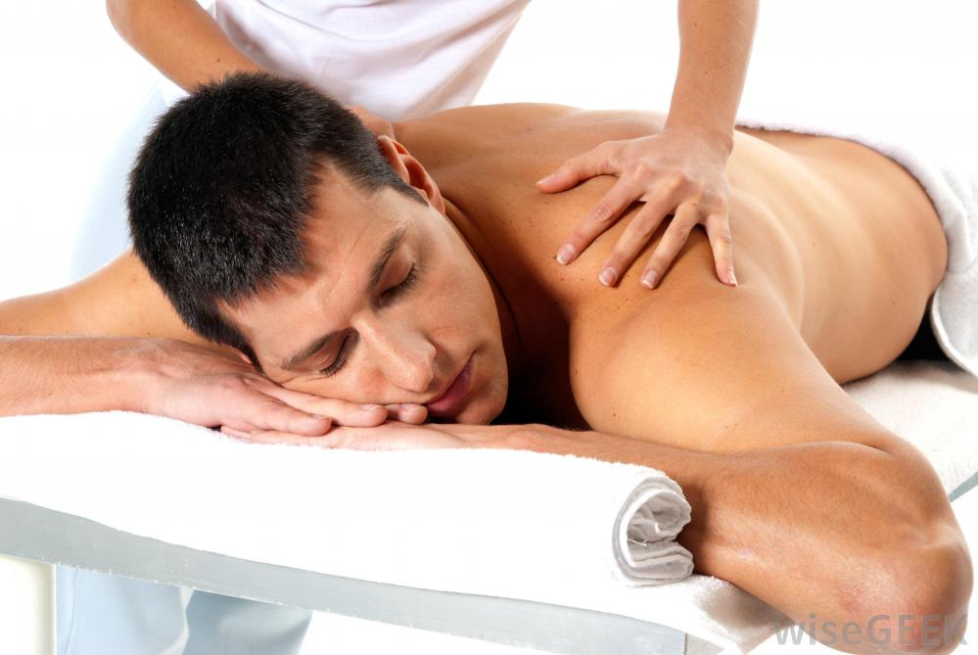
ICON Fitness
The Brilliance in Fitness
Home
Services
Calculators
Success Stories
Contacts
Services
Strength Training
Massage
Do you required Massage ?
Helps recovery from soft tissue injuries such as sprains and strains.
Tissue growth and repair is accelerated by efficient circulation and stimulation.
Increase the blood's oxygen capacity by 10-15%
Speed recovery from exercise-induced fatigue.
Various Injuries massage treat like Headaches and Migraines, Frozen Shoulder, Back Pain, and Much more………..

Slide 26
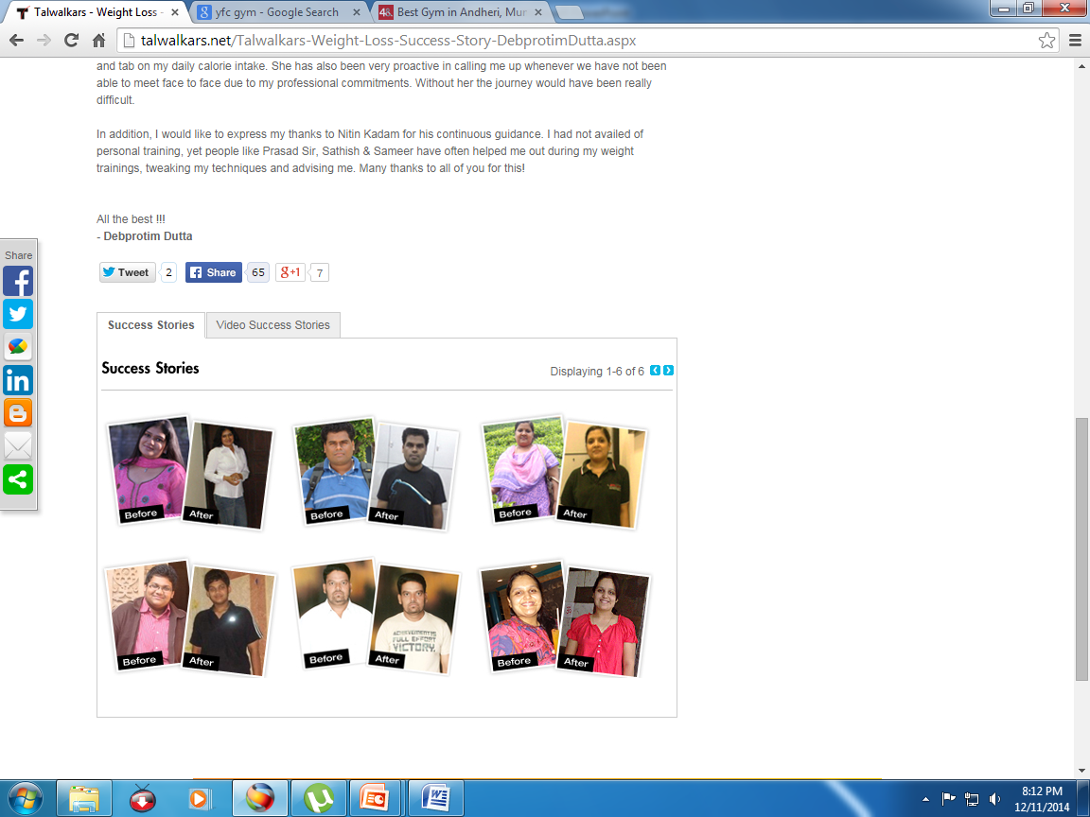
ICON Fitness
The Brilliance in Fitness
Home
Services
Calculators
Success Stories
Contacts
Success Stories

Slide 27
ICON Fitness
The Brilliance in Fitness
Home
Services
Calculators
Success Stories
Contacts
Success Stories

Slide 28
ICON Fitness
The Brilliance in Fitness
Home
Services
Calculators
Success Stories
Contacts
Ideal Weight
Body Mass Index
Body Fat
BMR

Slide 29
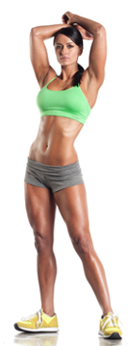
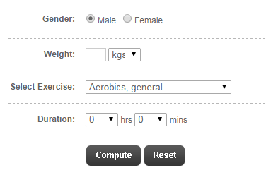
ICON Fitness
ICON Fitness
The Brilliance in Fitness
The Brilliance in Fitness
Home
Home
Services
Services
Calculators
Calculators
Success Stories
Success Stories
Contacts
Contacts
Ideal Weight
It is the weight range which keeps the person healthy.

Slide 30
ICON Fitness
ICON Fitness
The Brilliance in Fitness
The Brilliance in Fitness
Home
Home
Services
Services
Calculators
Calculators
Success Stories
Success Stories
Contacts
Contacts
Contact Us,,,
Address
Google Map
Rohini Group,
ICON Fitness,
Shop No.3, Sai Shristi , Sai Complex,
Joggers Park, Near Mira Road Station,
Mira Road – East , Thane – 401107
Tele No. – 91 022 28114627 Mob No - 91 8097230517
Opening Hours
Mon To Sat – 06.00 AM To 11.00 PM
Sunday – 09.00 AM To 12.00 AM

Slide 31
ICON Fitness
The Brilliance in Fitness
Home
Services
Calculators
Success Stories
Contacts
We create shapes
Your body is your Temple and needs
to be tended to in the best manner possible.
It is the finest and most valuable instrument ever created but it also has to be harmonize with the inner you. We believe in exercise that shapes and strengthens body and soul.

Slide 32
ICON Fitness
The Brilliance in Fitness
Home
Services
Calculators
Success Stories
Contacts
We create shapes
Your body is your Temple and needs
to be tended to in the best manner possible.
It is the finest and most valuable instrument ever created but it also has to be harmonize with the inner you. We believe in exercise that shapes and strengthens body and soul.

Slide 33
ICON Fitness
The Brilliance in Fitness
Home
Services
Calculators
Success Stories
Contacts
Services
Strength Training
Cardio Vascular Training
Weight Loss Training
Personal Training
Nutritional Counseling
Massage

Slide 34
ICON Fitness
The Brilliance in Fitness
Home
Services
Calculators
Success Stories
Contacts
Services
Strength Training
Strength Training
What Is Strength Training
Benefits of Strength Training
What we are Offering…
Weight training is a form of exercise where weights and the force of gravity combine to build and strengthen skeletal muscles. Regardless of age or gender, you can benefit from weight training.
Increases muscle and bone strength
Fat Loss
Increases Energy
Increases Metabolic Rate
Shapes your body
And much more…………….
From free weights to static weights, dumbbells , chest press or leg curl machines, ICON Fitness have everything you need for muscle toning and building.

Slide 35
ICON Fitness
The Brilliance in Fitness
Home
Services
Calculators
Success Stories
Contacts
Services
Cardio Vascular Training
Cardio Vascular Training
What Is Cardio Vascular
Benefits of Cardio Vascular Training
What we are Offering…
Any exercise that strengthens your heart and lungs while burning Calories.
.
Makes the heart and lungs stronger
Lowers blood pressure & cholesterol
Increases energy
Reduces stress And Much More…….
We are having international standard Treadmills, Elliptical/Cross Trainers
And Recumbent bike to enhance your cardio vascular strength and burn calories.

Slide 36
ICON Fitness
The Brilliance in Fitness
Home
Services
Calculators
Success Stories
Contacts
Services
Personal Training
Personal Training
What Is Cardio Vascular
Benefits of Cardio Vascular Training
What we are Offering…

Slide 37
ICON Fitness
The Brilliance in Fitness
Home
Services
Calculators
Success Stories
Contacts
Services
Functional Training
Functional Training
What Is Functional Training
Rather than focusing on one single muscle group, Functional training gives you the freedom to mimic natural forms of movement in all directions.
It'll train your body for activities performed in everyday life so you'll perform better at work and at home.
Improve your mobility, flexibility, balance and strength in all areas and decrease injuries and joint pain.
Helps to reduce your fats and gain muscles.

Slide 38
ICON Fitness
The Brilliance in Fitness
Home
Services
Calculators
Success Stories
Contacts
Services
Nutritional Counseling
Nutritional Counseling
Do you required Nutrition ?
If you feel tired halfway through your workout, you may not be eating enough. If you are gaining weight, you might be eating too much. If you are unintentionally losing weight, have a healthy snack in the afternoon before you head to the gym. Either way, your diet is not balanced, and the calories you ingest do not match the calories you expend. Your diet is most likely in balance once you are able to maintain a stable weight.

Slide 39
ICON Fitness
The Brilliance in Fitness
Home
Services
Calculators
Success Stories
Contacts
Services
Strength Training
Massage
Do you required Massage ?
Helps recovery from soft tissue injuries such as sprains and strains.
Tissue growth and repair is accelerated by efficient circulation and stimulation.
Increase the blood's oxygen capacity by 10-15%
Speed recovery from exercise-induced fatigue.
Various Injuries massage treat like Headaches and Migraines, Frozen Shoulder, Back Pain, and Much more………..

Slide 40
ICON Fitness
The Brilliance in Fitness
Home
Services
Calculators
Success Stories
Contacts
Success Stories

Slide 41
ICON Fitness
The Brilliance in Fitness
Home
Services
Calculators
Success Stories
Contacts
Success Stories

Slide 42
ICON Fitness
The Brilliance in Fitness
Home
Services
Calculators
Success Stories
Contacts
Ideal Weight
Body Mass Index
Body Fat
BMR

Slide 43
ICON Fitness
ICON Fitness
The Brilliance in Fitness
The Brilliance in Fitness
Home
Home
Services
Services
Calculators
Calculators
Success Stories
Success Stories
Contacts
Contacts
Ideal Weight
It is the weight range which keeps the person healthy.

Slide 44
ICON Fitness
ICON Fitness
The Brilliance in Fitness
The Brilliance in Fitness
Home
Home
Services
Services
Calculators
Calculators
Success Stories
Success Stories
Contacts
Contacts
Contact Us,,,
Address
Google Map
Rohini Group,
ICON Fitness,
Shop No.3, Sai Shristi , Sai Complex,
Joggers Park, Near Mira Road Station,
Mira Road – East , Thane – 401107
Tele No. – 91 022 28114627 Mob No - 91 8097230517
Opening Hours
Mon To Sat – 06.00 AM To 11.00 PM
Sunday – 09.00 AM To 12.00 AM

Slide 45
ICON Fitness
The Brilliance in Fitness
Home
Services
Calculators
Success Stories
Contacts
We create shapes
Your body is your Temple and needs
to be tended to in the best manner possible.
It is the finest and most valuable instrument ever created but it also has to be harmonize with the inner you. We believe in exercise that shapes and strengthens body and soul.

Slide 46
ICON Fitness
The Brilliance in Fitness
Home
Services
Calculators
Success Stories
Contacts
We create shapes
Your body is your Temple and needs
to be tended to in the best manner possible.
It is the finest and most valuable instrument ever created but it also has to be harmonize with the inner you. We believe in exercise that shapes and strengthens body and soul.

Slide 47
ICON Fitness
The Brilliance in Fitness
Home
Services
Calculators
Success Stories
Contacts
Services
Strength Training
Cardio Vascular Training
Weight Loss Training
Personal Training
Nutritional Counseling
Massage

Slide 48
ICON Fitness
The Brilliance in Fitness
Home
Services
Calculators
Success Stories
Contacts
Services
Strength Training
Strength Training
What Is Strength Training
Benefits of Strength Training
What we are Offering…
Weight training is a form of exercise where weights and the force of gravity combine to build and strengthen skeletal muscles. Regardless of age or gender, you can benefit from weight training.
Increases muscle and bone strength
Fat Loss
Increases Energy
Increases Metabolic Rate
Shapes your body
And much more…………….
From free weights to static weights, dumbbells , chest press or leg curl machines, ICON Fitness have everything you need for muscle toning and building.

Slide 49
ICON Fitness
The Brilliance in Fitness
Home
Services
Calculators
Success Stories
Contacts
Services
Cardio Vascular Training
Cardio Vascular Training
What Is Cardio Vascular
Benefits of Cardio Vascular Training
What we are Offering…
Any exercise that strengthens your heart and lungs while burning Calories.
.
Makes the heart and lungs stronger
Lowers blood pressure & cholesterol
Increases energy
Reduces stress And Much More…….
We are having international standard Treadmills, Elliptical/Cross Trainers
And Recumbent bike to enhance your cardio vascular strength and burn calories.

Slide 50
ICON Fitness
The Brilliance in Fitness
Home
Services
Calculators
Success Stories
Contacts
Services
Personal Training
Personal Training
What Is Cardio Vascular
Benefits of Cardio Vascular Training
What we are Offering…

Slide 51
ICON Fitness
The Brilliance in Fitness
Home
Services
Calculators
Success Stories
Contacts
Services
Functional Training
Functional Training
What Is Functional Training
Rather than focusing on one single muscle group, Functional training gives you the freedom to mimic natural forms of movement in all directions.
It'll train your body for activities performed in everyday life so you'll perform better at work and at home.
Improve your mobility, flexibility, balance and strength in all areas and decrease injuries and joint pain.
Helps to reduce your fats and gain muscles.

Slide 52
ICON Fitness
The Brilliance in Fitness
Home
Services
Calculators
Success Stories
Contacts
Services
Nutritional Counseling
Nutritional Counseling
Do you required Nutrition ?
If you feel tired halfway through your workout, you may not be eating enough. If you are gaining weight, you might be eating too much. If you are unintentionally losing weight, have a healthy snack in the afternoon before you head to the gym. Either way, your diet is not balanced, and the calories you ingest do not match the calories you expend. Your diet is most likely in balance once you are able to maintain a stable weight.

Slide 53
ICON Fitness
The Brilliance in Fitness
Home
Services
Calculators
Success Stories
Contacts
Services
Strength Training
Massage
Do you required Massage ?
Helps recovery from soft tissue injuries such as sprains and strains.
Tissue growth and repair is accelerated by efficient circulation and stimulation.
Increase the blood's oxygen capacity by 10-15%
Speed recovery from exercise-induced fatigue.
Various Injuries massage treat like Headaches and Migraines, Frozen Shoulder, Back Pain, and Much more………..

Slide 54
ICON Fitness
The Brilliance in Fitness
Home
Services
Calculators
Success Stories
Contacts
Success Stories

Slide 55
ICON Fitness
The Brilliance in Fitness
Home
Services
Calculators
Success Stories
Contacts
Success Stories

Slide 56
ICON Fitness
The Brilliance in Fitness
Home
Services
Calculators
Success Stories
Contacts
Ideal Weight
Body Mass Index
Body Fat
BMR

Slide 57
ICON Fitness
ICON Fitness
The Brilliance in Fitness
The Brilliance in Fitness
Home
Home
Services
Services
Calculators
Calculators
Success Stories
Success Stories
Contacts
Contacts
Ideal Weight
It is the weight range which keeps the person healthy.

Slide 58
ICON Fitness
ICON Fitness
The Brilliance in Fitness
The Brilliance in Fitness
Home
Home
Services
Services
Calculators
Calculators
Success Stories
Success Stories
Contacts
Contacts
Contact Us,,,
Address
Google Map
Rohini Group,
ICON Fitness,
Shop No.3, Sai Shristi , Sai Complex,
Joggers Park, Near Mira Road Station,
Mira Road – East , Thane – 401107
Tele No. – 91 022 28114627 Mob No - 91 8097230517
Opening Hours
Mon To Sat – 06.00 AM To 11.00 PM
Sunday – 09.00 AM To 12.00 AM

Slide 59
ICON Fitness
The Brilliance in Fitness
Home
Services
Calculators
Success Stories
Contacts
We create shapes
Your body is your Temple and needs
to be tended to in the best manner possible.
It is the finest and most valuable instrument ever created but it also has to be harmonize with the inner you. We believe in exercise that shapes and strengthens body and soul.

Slide 60
ICON Fitness
The Brilliance in Fitness
Home
Services
Calculators
Success Stories
Contacts
We create shapes
Your body is your Temple and needs
to be tended to in the best manner possible.
It is the finest and most valuable instrument ever created but it also has to be harmonize with the inner you. We believe in exercise that shapes and strengthens body and soul.

Slide 61
ICON Fitness
The Brilliance in Fitness
Home
Services
Calculators
Success Stories
Contacts
Services
Strength Training
Cardio Vascular Training
Weight Loss Training
Personal Training
Nutritional Counseling
Massage

Slide 62
ICON Fitness
The Brilliance in Fitness
Home
Services
Calculators
Success Stories
Contacts
Services
Strength Training
Strength Training
What Is Strength Training
Benefits of Strength Training
What we are Offering…
Weight training is a form of exercise where weights and the force of gravity combine to build and strengthen skeletal muscles. Regardless of age or gender, you can benefit from weight training.
Increases muscle and bone strength
Fat Loss
Increases Energy
Increases Metabolic Rate
Shapes your body
And much more…………….
From free weights to static weights, dumbbells , chest press or leg curl machines, ICON Fitness have everything you need for muscle toning and building.

Slide 63
ICON Fitness
The Brilliance in Fitness
Home
Services
Calculators
Success Stories
Contacts
Services
Cardio Vascular Training
Cardio Vascular Training
What Is Cardio Vascular
Benefits of Cardio Vascular Training
What we are Offering…
Any exercise that strengthens your heart and lungs while burning Calories.
.
Makes the heart and lungs stronger
Lowers blood pressure & cholesterol
Increases energy
Reduces stress And Much More…….
We are having international standard Treadmills, Elliptical/Cross Trainers
And Recumbent bike to enhance your cardio vascular strength and burn calories.

Slide 64
ICON Fitness
The Brilliance in Fitness
Home
Services
Calculators
Success Stories
Contacts
Services
Personal Training
Personal Training
What Is Cardio Vascular
Benefits of Cardio Vascular Training
What we are Offering…

Slide 65
ICON Fitness
The Brilliance in Fitness
Home
Services
Calculators
Success Stories
Contacts
Services
Functional Training
Functional Training
What Is Functional Training
Rather than focusing on one single muscle group, Functional training gives you the freedom to mimic natural forms of movement in all directions.
It'll train your body for activities performed in everyday life so you'll perform better at work and at home.
Improve your mobility, flexibility, balance and strength in all areas and decrease injuries and joint pain.
Helps to reduce your fats and gain muscles.

Slide 66
ICON Fitness
The Brilliance in Fitness
Home
Services
Calculators
Success Stories
Contacts
Services
Nutritional Counseling
Nutritional Counseling
Do you required Nutrition ?
If you feel tired halfway through your workout, you may not be eating enough. If you are gaining weight, you might be eating too much. If you are unintentionally losing weight, have a healthy snack in the afternoon before you head to the gym. Either way, your diet is not balanced, and the calories you ingest do not match the calories you expend. Your diet is most likely in balance once you are able to maintain a stable weight.

Slide 67
ICON Fitness
The Brilliance in Fitness
Home
Services
Calculators
Success Stories
Contacts
Services
Strength Training
Massage
Do you required Massage ?
Helps recovery from soft tissue injuries such as sprains and strains.
Tissue growth and repair is accelerated by efficient circulation and stimulation.
Increase the blood's oxygen capacity by 10-15%
Speed recovery from exercise-induced fatigue.
Various Injuries massage treat like Headaches and Migraines, Frozen Shoulder, Back Pain, and Much more………..

Slide 68
ICON Fitness
The Brilliance in Fitness
Home
Services
Calculators
Success Stories
Contacts
Success Stories

Slide 69
ICON Fitness
The Brilliance in Fitness
Home
Services
Calculators
Success Stories
Contacts
Success Stories

Slide 70
ICON Fitness
The Brilliance in Fitness
Home
Services
Calculators
Success Stories
Contacts
Ideal Weight
Body Mass Index
Body Fat
BMR

Slide 71
ICON Fitness
ICON Fitness
The Brilliance in Fitness
The Brilliance in Fitness
Home
Home
Services
Services
Calculators
Calculators
Success Stories
Success Stories
Contacts
Contacts
Ideal Weight
It is the weight range which keeps the person healthy.

Slide 72
ICON Fitness
ICON Fitness
The Brilliance in Fitness
The Brilliance in Fitness
Home
Home
Services
Services
Calculators
Calculators
Success Stories
Success Stories
Contacts
Contacts
Contact Us,,,
Address
Google Map
Rohini Group,
ICON Fitness,
Shop No.3, Sai Shristi , Sai Complex,
Joggers Park, Near Mira Road Station,
Mira Road – East , Thane – 401107
Tele No. – 91 022 28114627 Mob No - 91 8097230517
Opening Hours
Mon To Sat – 06.00 AM To 11.00 PM
Sunday – 09.00 AM To 12.00 AM

